Slide 1
Expressive Writing – Words That Heal

Slide 2
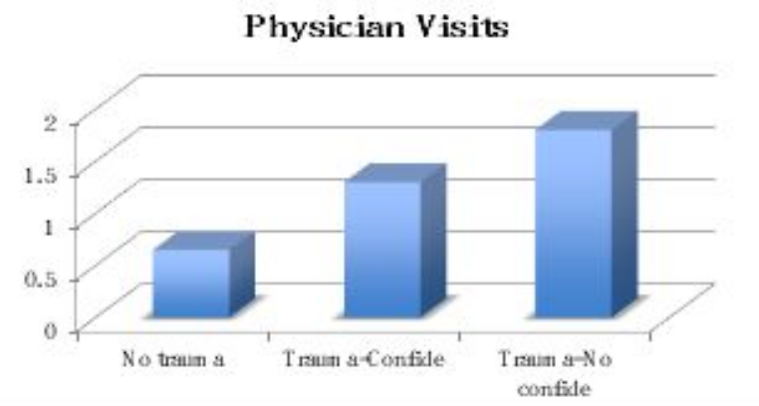
Chapter 1: Why Write about Trauma or Emotional Upheaval?
Emotional Writing: A Brief History
Figure 1. Yearly physician visits for illness among people who report not having had a childhood trauma (No Trauma), having had one or more traumas about which they confided (Trauma — Confide), or having had at least one significant childhood trauma that they had kept secret (Trauma — No Confide).

Slide 3
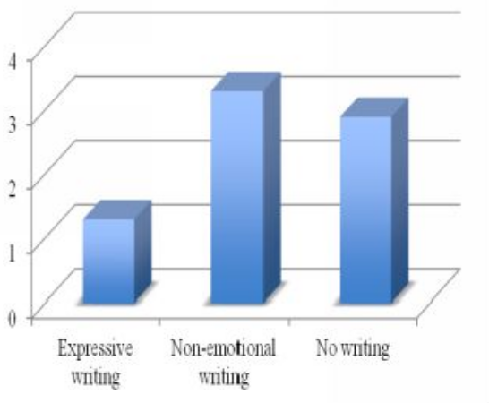
Figure 2. Yearly number of physician visits for illness in the three months after the experiment for participants in the emotional writing and control (non-emotional writing) conditions.
The No Writing data is based on students who did not participate in the experiment.

Slide 4
What Are the Effects of Writing?
Biological effects
The immune system.
The body’s immune system can function more or less effectively, depending on the person’s stress level.
Studies find that emotional writing is associated with general enhancement in immune function [1]
Medical markers of health.
Expressive writing finds usage in tracking general / overall health of the patient of any illness.
[1]: Koschwanez et al., 2013; Pennebaker, Kiecolt-Glasser & Glasser 1988; Lumley et al. 2011

Slide 5
Physiological indicators of stress
Somewhat surprisingly, while people write or talk about traumas, they often show immediate signs of reduced stress: lower muscle tension in their face, and drops in hand skin conductance (often used in lie detection to measure the stress of deception and also easily measured with readily available Biodot® skin thermometers). Immediately after writing about emotional topics, people have lower blood pressure and heart rates.

Slide 6
Psychological Effects
# Mood changes immediately after writing: Feeling sad is normal.
# Long-term mood changes.
Writing may make you sad for a brief time after writing, but the long-term effects are far more positive.

Slide 7
Behavioral Changes
# Performance at school or work:
Among beginning college students, expressive writing helps people adjust to their situation better.
# Working Memory
Working memory is the technical term for our general ability to think about complex tasks. If we are worrying about things — including emotional upheavals from the past — we have less working memory.
Expressive writing, we now know, frees working memory, allowing us to deal with more complicated issues in our lives (Klein & Boals 2001).
Students who did expressive writing about upcoming exams reported improved mood prior to their exams and improved performance (Dalton & Glenwick 2009; Frattaroli, Thomas, & Lyubomirsky 2011).

Slide 8
Dealing with our social lives.
Working with other people can sometimes be a daunting psychological task. The more emotional stress we are under, the more draining it is. Recent studies have suggested that expressive writing can enhance the quality of our social lives.

Slide 9
Writing Style
Some ways of writing appear to work better than others do. Recent studies by multiple labs are converging on some common guidelines. People tend to benefit most from expressive writing if they:
Openly acknowledge emotions.
Emotional experience is part of a trauma. The ability to feel and label both the negative and the positive feelings that occurred during and following the trauma is important.

Slide 10
Work to construct a coherent story.
Immediately after a trauma, things often seem out of control and disconnected. One goal of expressive writing is to begin to put things together again. One way of accomplishing this is to make a meaningful story of what happened and how it is affecting you. Many argue that the brain is a narrative organ and that story-making is hardwired into our very nature. Creating a narrative, including a coherent beginning, middle, and end, is a well-documented part of trauma treatment and holds much promise for benefits from writing about trauma.

Slide 11
Switch perspectives.
People who have experienced a trauma initially see it from one perspective — their own. Indeed, when individuals first write about a massive upheaval, they first describe what they saw, felt, and experienced. Recent studies indicate that people who benefit the most from writing have been able to see events through others’ eyes. Indeed, even writing about a personal event in the third person has proven beneficial (Andersson & Conley 2013; Campbell & Pennebaker 2003; Seih et al. 2011).

Slide 12
Find your voice.
A guiding principle of expressive writing is that you express yourself openly and honestly. People who write in a cold, detached manner and who quote Shakespeare, Aristotle, or Henry Ford may be fine historians and may even write a great editorial in the local newspaper. But impressive writing is not the point of expressive writing. People who benefit the most from writing are able to find a voice that reflects who they are.

